Slide 1

Introduction to…
…Technologies
Antonis Bikakis
Department of Information Studies, UCL
MIWAI 2016
Chiang Mai, December 2016

Slide 2
Outline
The Semantic Web Vision
Main Technologies
Linked Open Data
Semantic Web Applications
Demonstration of Protégé

Slide 3

The Semantic Web vision

Slide 4
A very common real-life scenario
Last September (2012) I went to a great folk rock concert in Islington, but I can’t remember the name of the singer.
Where was that?
At a club in Islington.
When was it exactly?
On the 4th of September.
Why don’t you google it?
Good idea!!!
Was it really a good idea?

Slide 5

Activity
Try to find the name of the singer who gave the concert using Google or any other search engine.

Slide 6
Why didn’t it work?
Problems of keyword-based search
High recall, low precision.
Low or no recall
Results are highly sensitive to vocabulary
Results are single Web pages
Human involvement is necessary to interpret and combine results

Slide 7
Today’s Web
Most of today’s Web content is suitable for human consumption
The meaning of Web content is not machine-accessible: lack of semantics
It is simply difficult to distinguish the meaning between:
Islington – a district in London
The Islington – a music club in London
Islington High Street – a street in London
Islington – the council

Slide 8

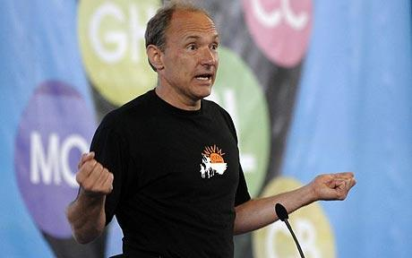
The Semantic Web Vision
“The Semantic Web is an extension of the current web in which information is given well-defined meaning, better enabling computers and people
to work in cooperation…”
“Properly designed, the Semantic Web can assist the evolution of human knowledge as a whole”
Scientific American, Featured Article: The Semantic Web, May 2001

Slide 9
The Semantic Web Approach
Exploit the underlying structure of web data.
Represent Web content in a form that is more easily machine-processable.
Use intelligent techniques to take advantage of these representations.

Slide 10

The Technologies

Slide 11
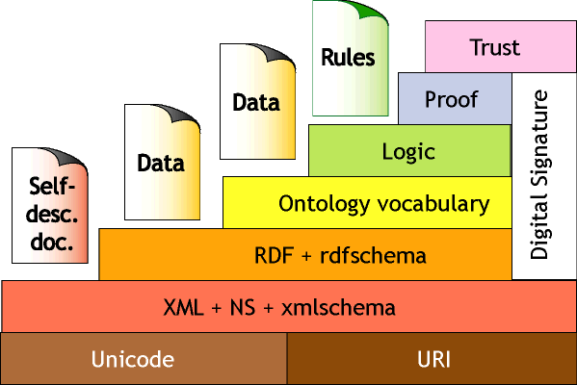
The Semantic Web Tower

Slide 12
From HTML
<h2>Great Folk Rock Concert!!!</h2>
<i>by <b>Eva Abraham</b></i>,
<br>at The Islington Club<br>
on September 4, 2012
Web content is currently formatted for human readers rather than programs
HTML is the predominant language in which Web pages are written (directly or using tools)
Vocabulary describes presentation

Slide 13
…to XML
<h2>Great Folk Rock Concert</h2>
<i>by <b>Eva Abraham</b></i>,
<br>at The Islington<br>
on 4 September, 2012
<concert> Great
<type>Folk Rock Concert</type> by
<singer>Eva Abraham</singer> at
<place>The Islington</place> on
<date>4 September 2012</date>
</concert>

Slide 14
Activity
Identify the similarities and differences between the html and xml representations.

Slide 15

Solution
Similarities
  Both use tags
  Same content
Difference
  Tags represent different things
    HTML tags describe how each information element should be displayed on the web page
    XML tags describe the structural relations between the elements of a web page

Slide 16
Explicit Metadata
Metadata: data about data
  Metadata capture part of the meaning of data
Semantic Web does not rely on text-based manipulation, but rather on machine-processable metadata

Slide 17

The RDF Data Model
Resource Description Framework
  A data model for describing metadata
The fundamental concepts of RDF are:
  resources
  properties
  statements

Slide 18
Resources
Resource: a specific “thing” we want to talk about
  E.g. Eva Abraham, Islington Club, London etc.
Every resource has a URI, a Universal Resource Identifier
A URI can be
  a URL (Web address) or
  some other kind of unique identifier
Advantages of using URIs:
  Α global, worldwide, unique naming scheme
  Reduces the homonym problem of distributed data representation

Slide 19
Properties
A special kind of resources
They describe relations between resources
  E.g. “singsAt”, “age”, “locatedIn”, etc.
Properties are also identified by URIs

Slide 20
Statements
Statements assert the properties of resources
  A statement consists of a resource (subject), a property (predicate) and a value (object)
  A value is either a resource or a literal
    Literals in RDF are used to identify data values (e.g. numbers, dates, etc.)
(http://www.music.org/ontology/singers.ttl#EvaAbraham,
http://www.music.org/ontology/music.ttl#singsAt,
http://dbpedia.org/resource/IslingtonClub)

Slide 21
Graphs
singsAt
EvaAbraham
IslingtonClub
Statement:
Two labelled nodes connected by a labelled arc
Arc (labelled by predicate) directed
  From the node labelled by the subject
  To the node labelled by the object

Slide 22
RDF Graph
singsAt
EvaAbraham
IslingtonClub
isA
isLocatedIn
comesFrom
UK
MusicClub
Islington
The object of a statement can be the subject of another statement.
Graphs can be created in a distributed fashion by using the same URIs
  => Web of Data

Slide 23
RDF Syntax
Turtle: RDF Triple Language
General syntax rules:
  URIs are enclosed in angle brackets
  Subject, predicate, object appear in order
  A statement ends with a period.
An example:
<http://www.music.org/ontology/singers.ttl#EvaAbraham>
<http://www.music.org/ontology/music.ttl#singsAt>
<http://dbpedia.org/resource/IslingtonClub>.
Other syntaxes: RDF/XML, RDFa

Slide 24
Ontologies
RDF is a universal data model that lets users describe resources in their own vocabularies
  RDF does not assume, nor does it define semantics of any particular application domain
To do so we use ontology languages
In Artificial Intelligence, an ontology is defined as:
an explicit and formal specification of a conceptualization
in simpler words: a formal description of a domain

Slide 25
Typical Components of Ontologies
Terms denote important concepts of the domain
  These can also be seen as sets of individuals sharing similar properties (classes)
    e.g. the class of singers, the class of clubs, etc.
  Individual objects that belong to a class are referred to as instances of the class
    e.g. Eva Abraham is an instance of the class of singers
Class hierarchy
  A class A is subclass of class B, if every object of A is also an object of B
  e.g. the class of singers is a subclass of the class of artists

Slide 26
Typical Components of Ontologies
Property definitions
  describe other types of relationships among the classes
  e.g. sings at relates singers with performance venues
Property hierarchy
  “singsAt” is a subproperty of “performsAt”
  If p sings at venue r, then p also performs at r
Domain/range restrictions
  Impose restrictions on what can be stated in an RDF document based on the ontology
  e.g. for property sings at:
    Domain restriction: singers (only singers can sing)
    Range restriction: performance venues (they can sing only at performance venues)

Slide 27
A Simple Ontology
Literal
range
address
performsAt
domain
range
domain
subPropertyOf
Performance Venue
Singer
singsAt
domain
range
subClassOf
subClassOf
Music
Club
Concert
Hall
isA
ontology
RDF
isA
EvaAbraham
The Islington
singsAt

Slide 28
Why are ontologies useful?
Ontologies provide a shared understanding of a domain: semantic interoperability
  overcome differences in terminology
  mappings between ontologies
Ontology languages
  RDFS: RDF Vocabulary Description Language
    classes, properties, class hierarchy, property hierarchy, domain and range restrictions
  OWL: Standard ontology language for the Web

Slide 29
Activity
Draw an ontology graph representing the following geography-related concepts:
  States, cities and countries are different types of places. Each city is located in a country. A city can also be the capital of a country. Each state belongs to a country. Countries border other countries. Each place has a population.

Slide 30
Solution
range
population
Literal
domain
Place
subClassOf
subClassOf
islocatedIn
subClassOf
domain
range
subPropertyOf
Country
City
isCapitalOf
domain
range
range
domain
borders
State
isPartOf

Slide 31
Activity
Extend the ontology graph with appropriate RDF statements to represent the following:
  Chiang Mai is located in Thailand.
  Bangkok is located in Thailand. It is also the capital of Thailand.
  The population of Chiang Mai is 148,477.

Slide 32
Solution (A)
City
isLocatedIn
Country
domain
range
ontology
RDF
isA
isA
Chiang Mai
Thailand
isLocatedIn

Slide 33
Solution (B)
islocatedIn
subPropertyOf
City
isCapitalOf
Country
domain
range
ontology
RDF
isA
isA
Bangkok
Thailand
isCapitalOf

Slide 34
Solution (C)
Place
population
Literal
domain
range
subClassOf
City
ontology
RDF
isA
isA
Chiang Mai
148,477
population

Slide 35

OWL (Web Ontology Language)
RDFS elements
  classes, properties, class hierarchy, property hierarchy, domain and range restrictions
Additional representation capabilities
  Disjointness of classes
    male, female
  Booleans combinations of classes
    person is the disjoint union of male and female
  Cardinality restrictions
    a person has exactly two parents
  Special characteristics of properties
    Transitive property (e.g. is greater than)
    Unique property (e.g. is mother of)

Slide 36
Example Ontology (RDFS)
Literal
range
address
domain
isNextTo
domain
range
occupies
Unit
domain
domain
range
isBigger
Than
subPropertyOf
range
subClassOf
Person
domain
rents
range
Residential Unit
subClassOf
subClassOf
Flat
House

Slide 37
Property types
Object Properties
  Relate resources to other resources
    e.g. rents (relates persons with residential units)
Datatype Properties
  Relate resources to data values
    e.g. address (relates units with strings of characters)
Annotation Properties
  They add labels, comments, explanations

Slide 38
Property types (cont’d)
Transitive Properties
  e.g. is bigger than
    if a unit a is bigger than unit b, and b is bigger than unit c, then a is bigger than c
Symmetric Properties
  e.g. is next to
    if a unit a is next to unit b, then b is next to a
Functional Properties
  e.g. address
    each unit has one address
Other property types
  asymmetric, inverse functional, reflexive, irreflexive

Slide 39
Property axioms
Inverse of a property
  e.g. is rented by is inverse of rents
    if a person a rents residential unit b, then b is rented by a
Disjoint Properties
  e.g. rents is disjoint with owns
    a person cannot rent and own a residential unit at the same time
Property Chains
  e.g. lives at is a property chain of rents and address
    If a person a rents a residential unit b and b has address c, then a lives at c
Equivalent Properties
  Two properties that have exactly the same meaning

Slide 40
Class axioms
Equivalent classes
  Classes that have exactly the same members
    e.g. flat is equivalent to apartment
Disjoint classes
  No member of one class can also be member of the other.
    e.g. studio flat is disjoint with two-bedroom flat
Complement of a class
  The complement of a class A is the class of all things that are not members of A.
    e.g. unfurnished flat is the complement of furnished flat

Slide 41
Class axioms (cont’d)
Union of classes
  Every member of a union of classes is a member of at least one of the classes in the union.
    e.g. university staff is the union of academics and unfurnished flat
Disjoint union
  A union that its member classes are disjoint
    e.g. flat is the disjoint union of furnished flat and unfurnished flat
Intersection of classes
  Every member of an intersection of classes is a member of all the classes in the intersection.
    e.g. basement studio is the intersection of basement flat and studio flat

Slide 42
Property Restrictions
Universal restriction
  A universal restriction on class C and property p states that for every member of C all values of p belong to a certain class.
    e.g. a hotel is superior if all its rooms are first-class:
    Superior hotel is a class that for all its members, all values of has room belong to class first-class room
Existential restriction
  An existential restriction on class C and property p states that for every member of C at least one value of p belongs to a certain class.
    e.g. a flat is basement if it has at least one underground room:
    Basement is a class that for all its members, at least one value of has room belongs to class underground room

Slide 43
Property Restrictions (cont’d)
Value restriction
  A universal restriction on class C and property p states that for every member of C, p has a specific value.
    e.g. a London house is a house located in London:
    London house is a class that for all its members, the value of is located in is London
Cardinality restrictions
  A cardinality restriction restricts the number of values that a certain property can take.
    e.g. a flat is studio if it has one room:
    Studio is a class that for all its members, has room takes one value
  maxCardinality, minCardinality, Cardinality

Slide 44
Identity of individuals
Unique Names Assumption: different names refer to different things in the world
OWL does not make this assumption:
  Different URIs may refer to the same things
Identity assertions
  sameAs: two URIs refer to the same individual
  differentFrom: two URIs refer to different individuals
  AllDifferent: each URI in a list refers to a different individual

Slide 45
Activity
Given the ontology in slide 27:
  Which of its properties would you describe as object properties and which as datatype properties?
  Would you describe borders as a transitive property or as a symmetric property?
  Which of the existing properties would you describe as functional?
  Give one example of a property that you would define as the inverse of one of the existing properties.

Slide 46
Activity (cont’d)
Given the ontology in slide 27:
  Think of an example of two classes that you would describe as disjoint.
  Which class axioms would you use to define the following:
    A region is something that is either a country or a state.
    A northern European country is a country that is both European and northern.
  Which restrictions would you use to define the following:
    A central European country is a European country that borders only European countries.
    A Thai city is a city that is located in Thailand.
    An island country is a country that doesn’t border any other countries.

Slide 47
Solution
  The only datatype property is population. All other properties are object properties.
  borders is symmetric but not transitive.
  Except for borders, all other properties are functional.
  has Capital with domain Country and range City is the inverse of isCapitalOf
  City is disjoint with Country
  i) Region is the union of Country and State, ii) European Country and Northern Country are subclasses of Country; Northern European Country is the intersection of European Country and Northern Country
  i) Universal restriction on property borders ii) Value restriction on property isLocatedIn iii) Cardinality restriction on property borders

Slide 48
SPARQL
Query Language for RDF
Select, extract, create views of RDF data
Many similarities with SQL (database query language)

Slide 49
How can I use SPARQL?
Find / install a triple store (database for RDF)
Populate with RDF data
Submit your query via the SPARQL endpoint
Online endpoints
  http://sparql.org/sparql.html
    General-purpose query endpoint for Web-accessible data
  http://dbpedia.org/sparql
    Extensive RDF data from wikipedia
  http://semantic.eea.europa.eu/sparql
    European environmental datasets and related ontologies
  http://www.w3.org/wiki/SparqlEndpoints
    A list of SPARQL endpoints available on line

Slide 50
How does SPARQL work?
SPARQL is based on matching graph patterns
The simplest graph pattern is the triple pattern
  like an RDF triple, but with the possibility of a variable instead of an RDF term in the subject, predicate, or object positions
Combining triple patterns gives a basic graph pattern, where an exact match to a graph is needed to fulfill a pattern

Slide 51
Example SPARQL Query
PREFIX music: <http://www.music.org/ontology/music.ttl#>
PREFIX dbpedia: <http://dbpedia.org/resource/>
SELECT ?singer
WHERE {
?singer music:singsAt dbpedia:IslingtonClub
}
Results (bindings)
(assuming that the following triple is in our RDF dataset)
singers:EvaAbraham music:singsAt dbpedia:IslingtonClub.
? singer
singers:EvaAbraham

Slide 52
Logic and Inference
Logic is the discipline that studies the principles of reasoning
Formal languages for expressing knowledge
Well-understood formal semantics
Automated reasoners can deduce (infer) conclusions from the given knowledge

Slide 53
Inference Example
From these logical statements:
singer(X) → artist(X)
artist(X) → person(X)
singer(EvaAbraham)
We can deduce the following conclusions:
artist(EvaAbraham)
person(EvaAbraham)
singer(X) → person(X)

Slide 54
Predicate Logic Specializations
RDF and OWL
  They provide a syntax that fits well with their use
  They correspond to different subsets of predicate logic (description logics) for which proof systems exist
  Tradeoff: expressive power vs. computational complexity
Horn Logic (Prolog)
  Rules of the form
A₁,…,A_{n} → B
  Two ways of reading such a rule
  Deductive rules: If A₁,…,A_{n} are known to be true, then B is also true
  Reactive rules: If the conditions A₁,…,A_{n} are true, then carry out the action B

Slide 55
Description Logics vs. Horn Logic
Neither of them is subset of the other
Example: A person X is an ancestor of Y, if X is the parent of Y, or if X is an ancestor of the parent of Y.
  Using rules (Horn Logic):
  parent(X,Y) → ancestor(X,Y)
  ancestor(X,P),parent(P,Y) → ancestor(X,Y)
  We cannot express that in OWL
Example: A person is either a man or a woman
  We cannot express that using rules
  We can express that in OWL using disjoint union.

Slide 56
Rules on the Semantic Web
Rules Exchange and Markup
  RIF: Rule Interchange Format
  RuleML: Rule Markup Language
Rules in SPARQL
Semantic Web Rule Languages
  SWRL: the Semantic Web Rule Language
  OWL2RL: Intersection of OWL and Horn Logic

Slide 57
Proof and Trust Layers
Proof
  Explanation of inference results, data provenance
  Need for a proof representation language
  Need for proof systems
Trust
  Trust that the system performs correctly
  Trust that the system can explain what it is doing
  Web of Trust
  Relevant technologies: digital signatures, recommendation and rating systems

Slide 58
The Semantic Web Tower

Slide 59
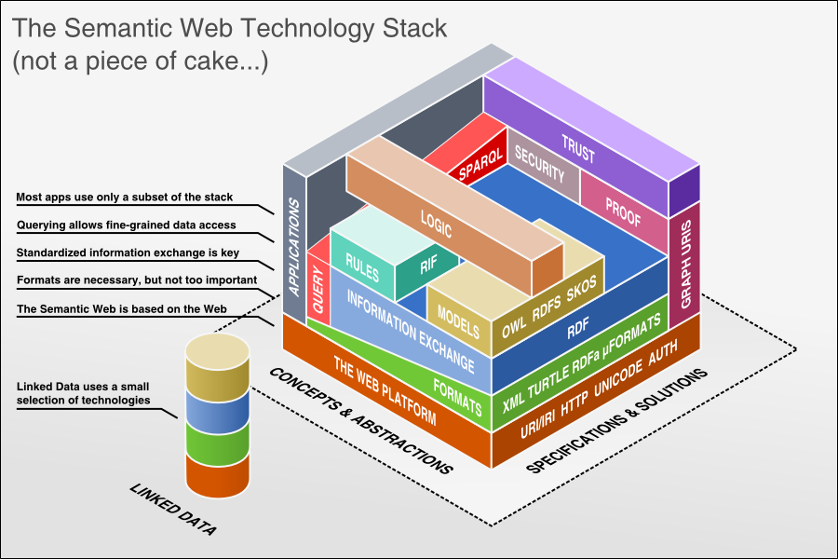
…and a more modern version

Slide 60
Linked Open Data

Slide 61
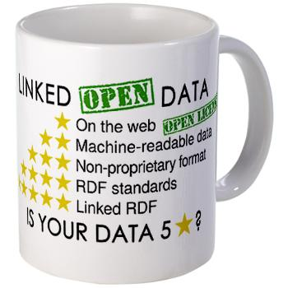
A new vision!
“…a new web of open, linked data”
“the more data is connected together, the more powerful it is”
TED Conference, “Tim Berners-Lee on the next Web”
February 2009

Slide 62

LOD: Main ideas
Goal
  Expose open datasets in RDF
Methodology
  Set RDF links among the data items from different datasets
  Set up, if possible, query endpoints
62

Slide 63
Example: DBpedia
A community effort to
  extract structured information from Wikipedia
  provide a query endpoint to the dataset
  interlink the DBpedia dataset with other datasets on the Web
Access it online at
  http://dbpedia.org/About
  http://dbpedia.org/sparql (query endpoint)
63

Slide 64
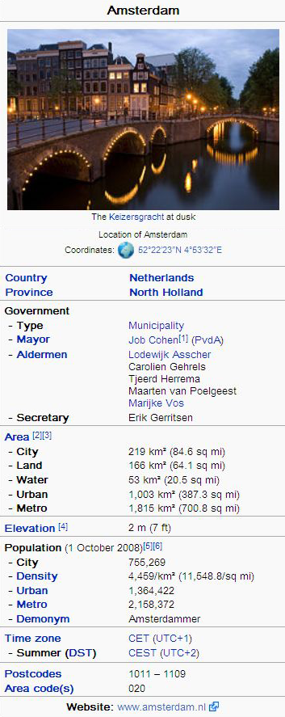
Extracting structured data from Wikipedia
@prefix dbpedia <http://dbpedia.org/resource/>.
@prefix dbterm <http://dbpedia.org/property/>.
dbpedia:Amsterdam
dbterm:officialName "Amsterdam" ;
dbterm:longd "4” ;
dbterm:longm "53" ;
dbterm:longs "32” ;
dbterm:leaderName dbpedia:Lodewijk_Asscher ;
...
dbterm:areaTotalKm "219" ;
...
dbpedia:ABN_AMRO
dbterm:location dbpedia:Amsterdam ;
...
64

Slide 65
Automatic links among open datasets
<http://dbpedia.org/resource/Amsterdam>
owl:sameAs <http://rdf.freebase.com/ns/...> ;
owl:sameAs <http://sws.geonames.org/2759793> ;
...
<http://sws.geonames.org/2759793>
owl:sameAs <http://dbpedia.org/resource/Amsterdam>
wgs84_pos:lat "52.3666667" ;
wgs84_pos:long "4.8833333";
geo:inCountry <http://www.geonames.org/countries/#NL> ;
...
65

Slide 66
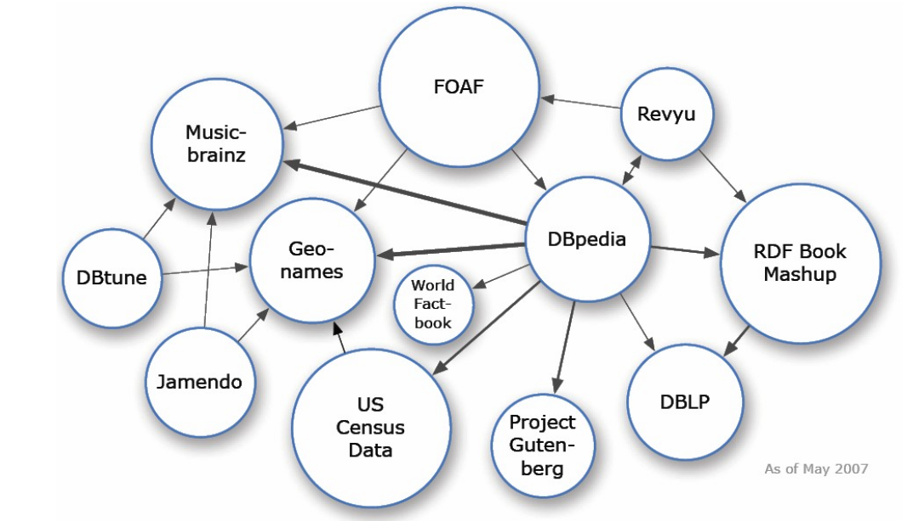
The Linked Data Cloud (2007)

Slide 67
The Linked Data Cloud (2014)
Source: http://lod-cloud.net/

Slide 68
Applications

Slide 69
Semantic Web Applications
E-Commerce
  GoodRelations Ontology
News sites and agencies
  BBC Music, BBC Sports, …
    www.bbc.co.uk/music, http://www.bbc.co.uk/worldcup/, http://www.bbc.co.uk/sport/0/olympics/2012/
  New York Times
  Thomson Reuters (OpenCalais)
    http://viewer.opencalais.com
Government data sites
  http://data.gov.uk, http://data.worldbank.org (world bank site), http://ec.europa.eu/eurostat/ (OpenCalais)
Semantic Search Engines
  http://www.schema.org (Google, Yahoo, Microsoft)

Slide 70
GoodRelations
OWL ontology for e-commerce
Its RDFa syntax allows e-commerce information to be embedded in web sites.
Benefits
  improves search
    e.g. more specific queries, more precise answers
  improves visibility of offers in modern search engines (e.g. Google, Yahoo) and recommender systems
  allows expression of commercial and functional details of e-commerce transactions
    e.g. eligible countries, payment and delivery options, discounts
An example of success: BestBuy (www.bestbuy.com)
  30% increase in search traffic

Slide 71
The BBC Music Site
BBC Music Beta project
  A BBC effort to build semantically annotated web pages for singers (www.bbc.co.uk/music)
  pulling information from external sites
    e.g. Wikipedia, MusicBrainz
  mapping this information to its own data schema
  based on RDF!
“Part of a general BBC movement to publish data that may be used in a more dynamic way across the web”
Other similar BBC efforts
  programme information (www.bbc.co.uk/programmes)
    URIs for programmes, BBC’s programme ontology
  the BBC World Cup 2010 web site
  the BBC Olympics 2012 web site

Slide 72
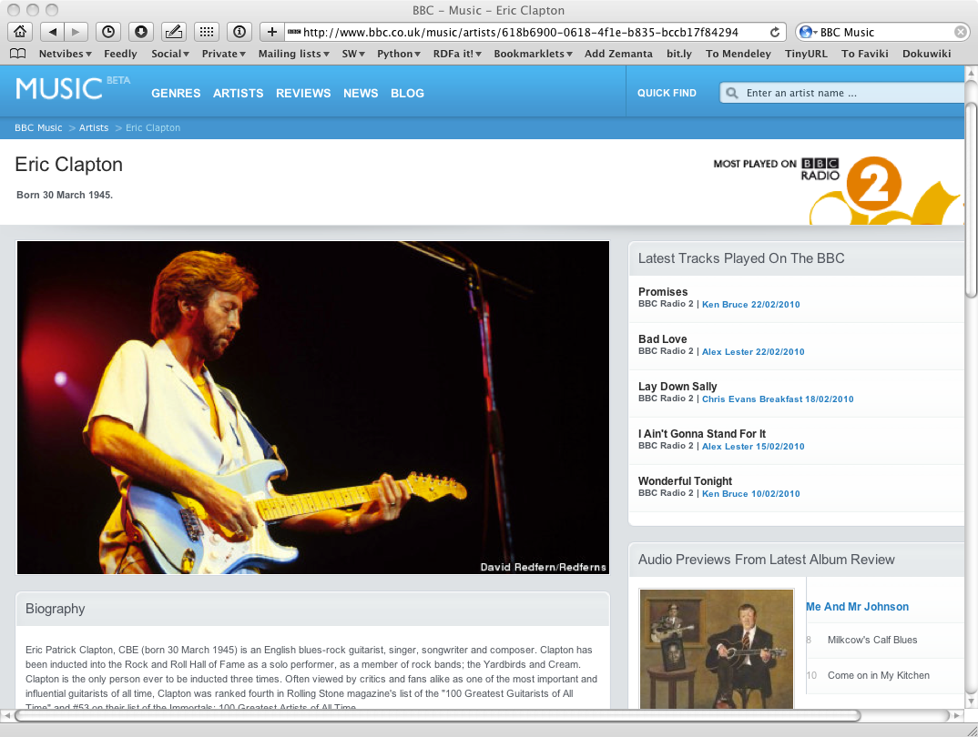
The BBC Music Site (cont’d)

Slide 73
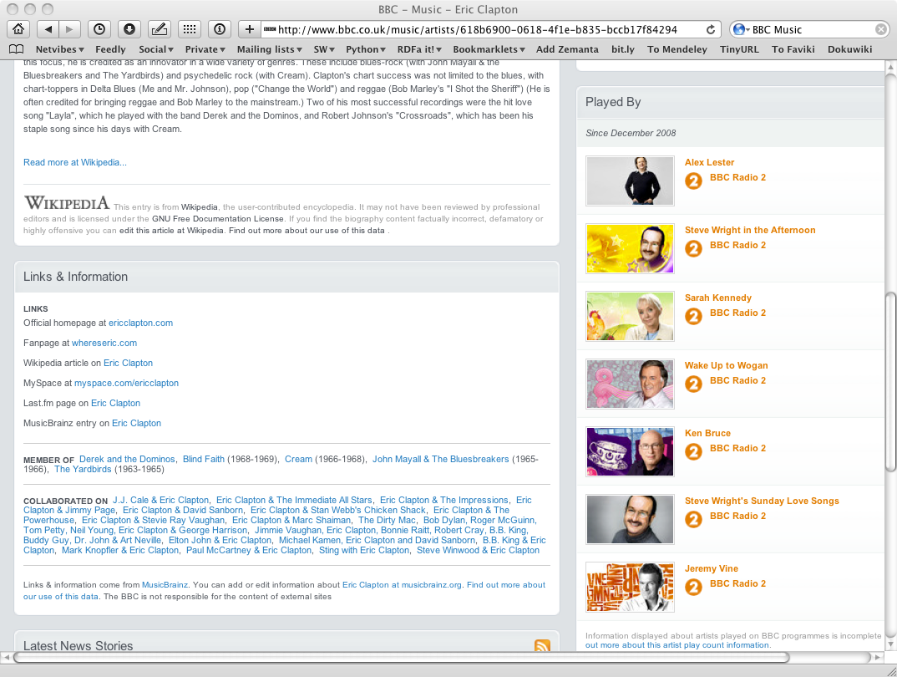
The BBC Music Site (cont’d)

Slide 74
Government data
Publishing government data sources is a crucial step towards transparency
Semantic Web is a key technology for this
http://data.gov.uk
  250,000 datasets from
  250 government agencies
    e.g. economic indicators, health-service statistics, environmental data
  Much of this data follows the Linked Data Initiative
    RDF, URIs, ontologies, links to other datasets
  Third-party applications on top of this data
    e.g. http://www.wheredidmytaxgo.co.uk

Slide 75
Similar Efforts
Government sites
  Canada, Ireland, Norway, Australia, New Zealand, US states
Citizen initiatives
  e.g. in France, Italy, Denmark, Austria, Germany
Inter-governmental agencies
  World Bank (http://data.worldbank.org)
  EC site for European tendering procedures (http://ted.europa.eu)
  Eurostat (http://ec.europa.eu/eurostat/)

Slide 76
New York Times
Index of subjects covered maintained by NY Times
  30,000 subject headings
Every article (since 1851!) tagged with subject headings
Tags are being used to
  provide news-alerting services
  automate the editorial process
  build topic pages
In 2009, they started using the Semantic Web formats
  headings in RDF
  terms linked to the LOD Cloud
    DBPedia, FreeBase, GeoNames, etc.
    helps to provide geographic information for articles, align with other data sources of the newspaper

Slide 77
OpenCalais
Motivated by the observation of Thompson Reuters that
many of the consumers of their news items are computers
OpenCalais Service helps computers process news items by
  analysing text
  recognising entities (people, locations, companies, etc.)
  annotating the text with RDF
Semantic Web Technologies used
  URIs to identify the entities
  RDF to annotate entities
  Links to LOD datasets
    DBPedia, FreeBase, GeoNames, etc.
OpenCalais Viewer: http://www.opencalais.com/opencalais-demo/

Slide 78
Schema.org
Effort by search engine providers to encourage semantic markup of pages
  Google, Yahoo, Microsoft, Yandex
A common schema (http://www.schema.org)
  for common things that people search for
  helps to better index pages and improve precision of results
Semantic Web Technologies used
  RDFa
  microdata

Slide 79






























And more are on the way…

Slide 80

Describe yourself in RDF!
Friend Of A Friend Ontology (FOAF)
  The first Semantic Web Application
Describing
  People, activities, relations to other people
Semantic Web Technologies
  OWL, RDF
Create your FOAF file at
  http://www.ldodds.com/foaf/foaf-a-matic
  Add me as your friend ☺
    http://www.ucl.ac.uk/dis/people/antonis/foaf.rdf
  Upload it on your personal page

Slide 81
Useful resources
A Semantic Web Primer, 3rd edition, Grigoris Antoniou, Paul Groth, Frank van van Harmelen, Rinke Hoekstra
Protégé ontology editor:
  http://protege.stanford.edu/
Online resources and tutorials:
  http://www.semanticweb.org
  http://www.w3schools.com/xml/xml_rdf.asp (RDF/S Tutorial)
  http://w3schools.sinsixx.com/rdf/rdf_owl.asp.htm (OWL Tutorial)
  http://jena.apache.org/tutorials/sparql.html (SPARQL Tutorial)
  http://goo.gl/eozSbY (Protégé tutorial on YouTube)

